Slide 1
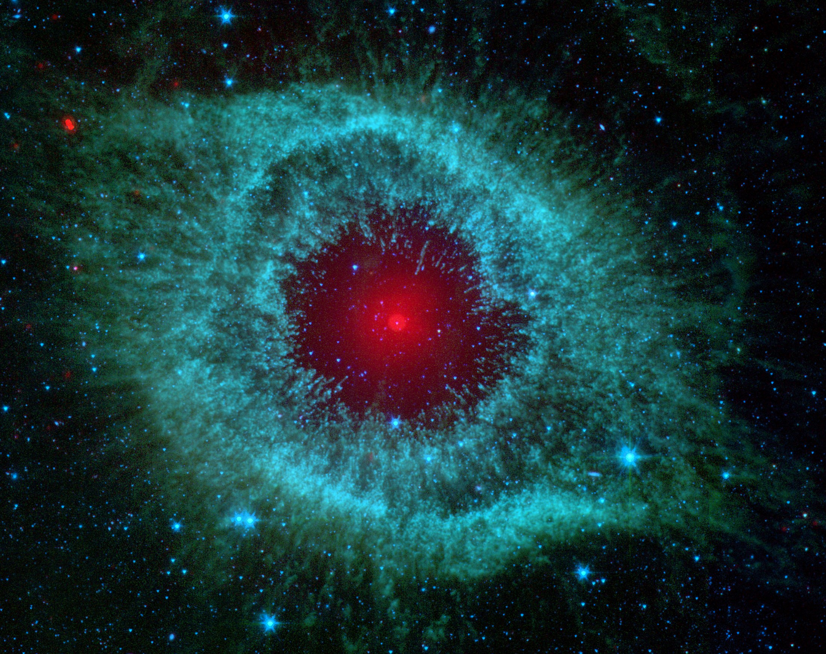
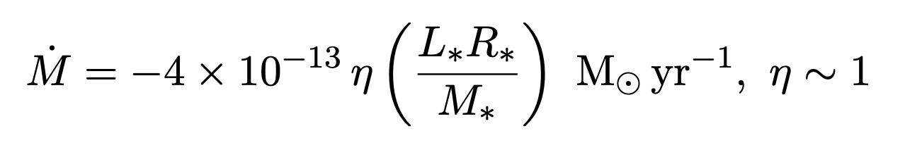
Formation of Planetary Nebulae: Mass Loss Mechanisms
Stellar Winds
NASA/
JPL-Caltech/
Univ. of Ariz.
Radiation pressure from star imparts momentum on condensed dust particles in the stellar atmosphere
Friction causes the dust to drag gases along with it as it is pushed away from the star
PN is a cloud composed of ionized gas ejected from a low- to intermediate-mass star at the end of its stellar lifetime
Characteristic glow caused by ionizing UV radiation from central star
Requires temperature of ~30,000K and at least 100 particles/cm³
Model mass loss due to winds using Reimers’ formula:
Assume that mass loss rate is proportional to luminosity (more radiation pressure), and inversely proportional to M/R (surface gravity is M/R²). AGB stars have large radii (several hundred solar radii) but are not significantly more massive than the Sun. Low surface gravity!
Luminosity increases (see HRD), and mass decreases. Increasing mass loss rate!
Where does all that gas come from? Stellar winds, pulsation
Notes:
Hi! I’m Jeff and the topic I’m researching is the formation of planetary nebulae, which are clouds of ionized gases. The primary driver behind the transition from AGB star to planetary nebula is mass loss. An AGB star starts off with several solar masses, but ends up as a white dwarf, which is at most 1.4 solar masses. So naturally, you would ask where all that mass went. As it turns out, that lost mass is what a planetary nebula is made of. The two primary mechanisms that drive mass loss are stellar winds and pulsation.
Stellar winds are caused by radiation pressure from the star imparting momentum onto grains of dust in the stellar atmosphere. As these grains of dust are ejected away from the star, they carry some of the surrounding gases along with them. Just knowing this, we can derive a mass loss equation. This one, given by Reimers, is widely used to model mass loss due to stellar winds: proportional to luminosity (more luminosity means more radiation pressure), and inversely proportional to M over R (which is like a term for surface gravity). The coefficients are just there to match observational data.
One important thing to keep in mind is the position and evolution of an AGB star on the HR-Diagram (draw diagram). AGB stars are much more luminous than Sun-like stars, and one of the relations that we know is that more luminous stars are bigger! AGB stars are in the range of several hundred solar radii but are at most several solar masses. Knowing this, we can deduce that the surface gravity of an AGB star is much weaker than that of a Sun-like star. Furthermore, as an AGB star evolves, it moves further up along the diagram, meaning that mass loss increases as the star ages.

Slide 2
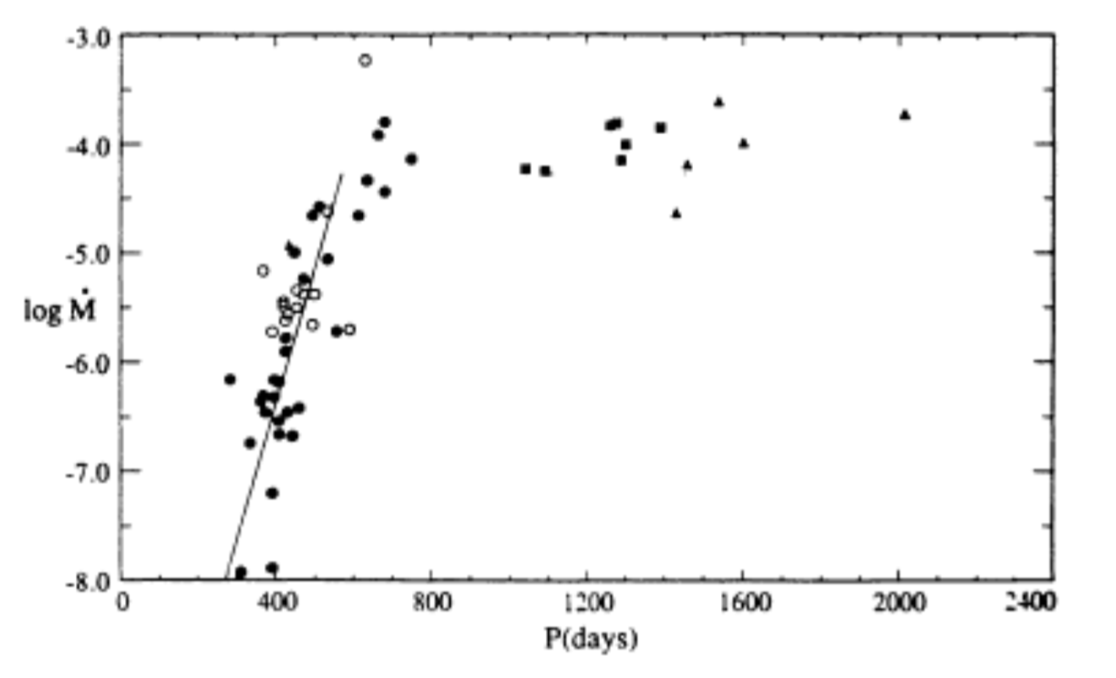
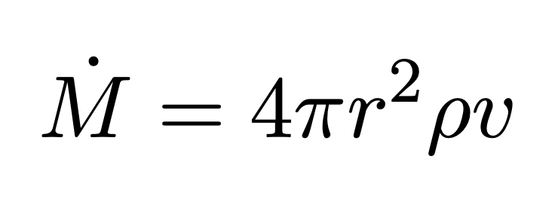
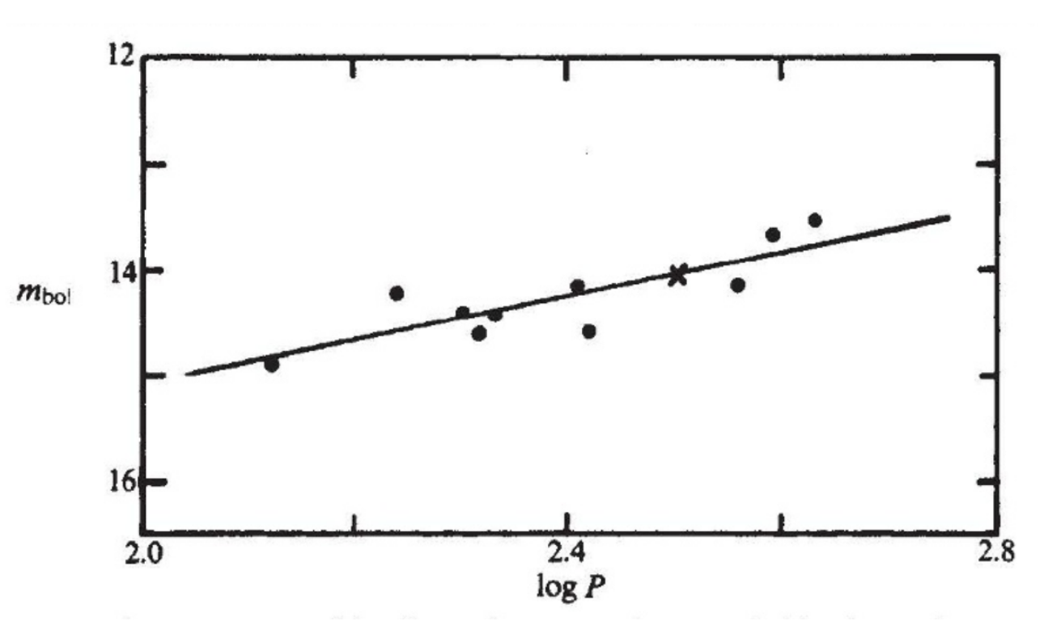
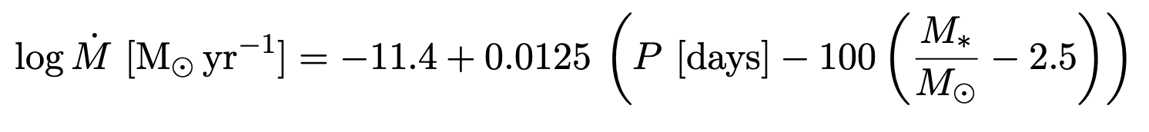
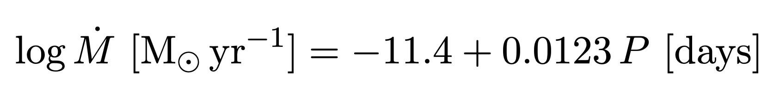
Pulsation
Late-stage AGB stars are called thermally pulsate
Unstable shell burning causes helium shell flashes, and causes the star to expand and contract as it attempts to maintain equilibrium
Produces shock waves that levitates material—increases the density of material in the stellar atmosphere.
Vassiliadis, E., Wood, P.R. 1993, ApJ, 413, 641
For stars with M >= 2.5 solar masses:
For stars with M <= 2.5 solar masses:
Glass, I.S., Evans, T.L. 1981, Nature, 291, 303
Period of pulsation also related to luminosity!
Notes:
Late-stage AGB stars also pulsate due to instability of double-shell burning, and that causes shock waves which levitate dust in the stellar atmosphere. We can think of the mass loss rate as being, very approximately, the amount of material in a shell that is being pushed away, and how fast material is being pushed away. If pulsation increases the density of dust. Researchers also found that pulsation period, which increases as a star ages, is positively correlated with luminosity (this might not be causal but that’s not the important thing). From these two relations, we can guess that an increasing pulsation period would lead to increasing mass loss rates. That is, in fact, what we see. In fact, past a period of 300~ days, there is a sharp increase in mass loss rate, which are given by these empirical formulas. This suggests that mass loss increases exponentially towards the end of a star’s lifetime, and that might be the cause for the ”superwind” which causes the formation of a planetary nebula.

